Slide 1
WELCOME EVERYONE TO OUR PROJECT TOPIC- ECOMMERCE PROJECT
SUBMITTED TO:
Dr. Fernaz Narin Nur (Associate Professor NDUB)
SUBMITTED BY:
NAME: ANISUR RAHMAN NAEEM
ID NO.: 0692220005101015
BATCH: CSE-19
NAME: SHAZIDUL ALAM
ID NO.: 0692220005101009
BATCH: CSE-19
NAME: Faisal Morshed Akash
ID NO.: 0692220005101007
BATCH: CSE-19

Slide 2
WHAT IS AN ECOMMERCE PROJECT?
An e-commerce project is like a big plan to make or improve websites where you can buy and sell stuff. It's like the main way businesses do their thing online, using tech, design, and marketing to make it easy for you to buy stuff. The main job of an e-commerce project is to help businesses do well online by reaching more people, selling more stuff, and keeping up with what customers like.
01

Slide 3
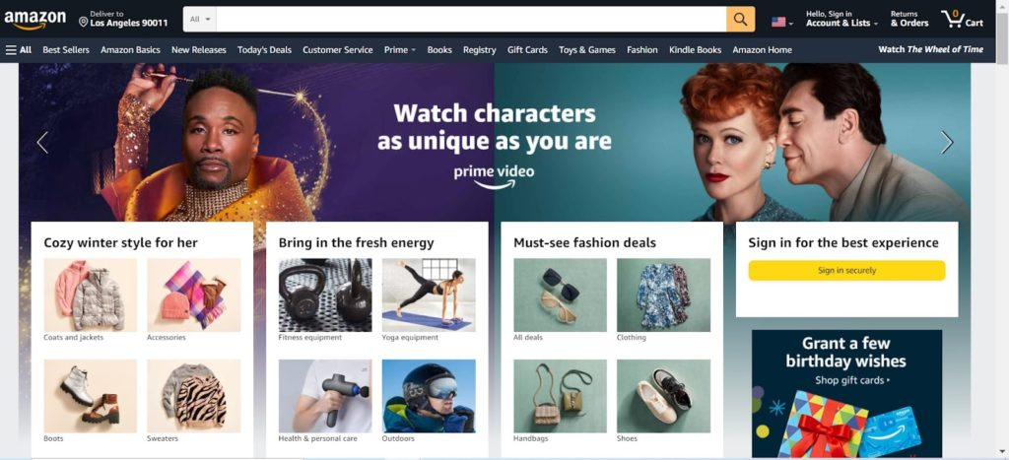
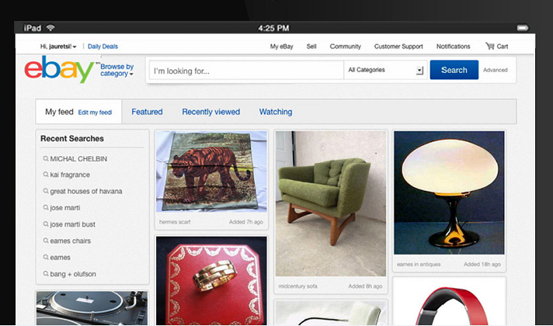
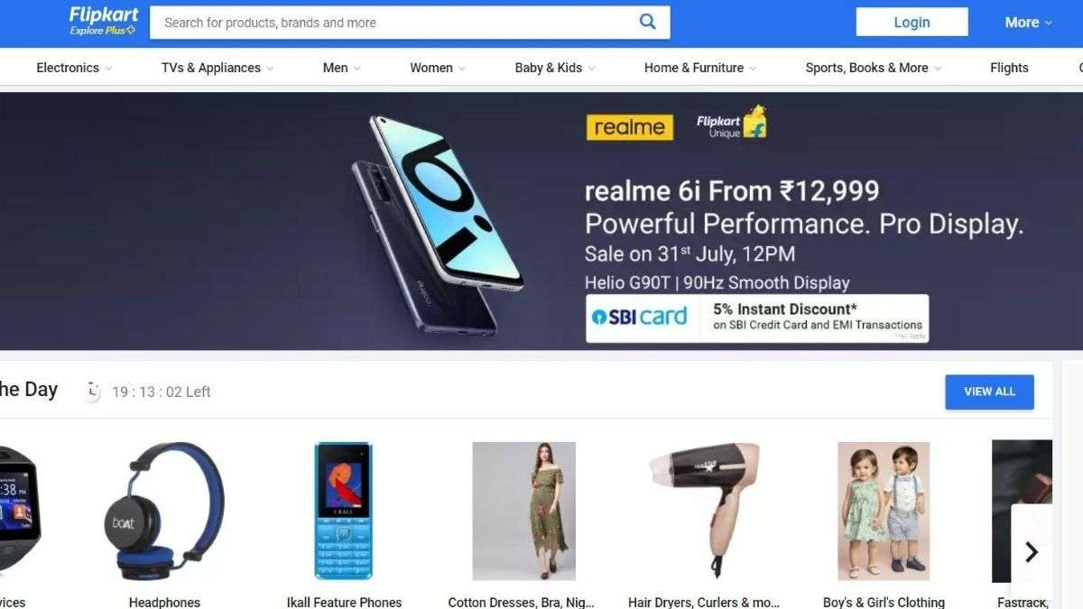
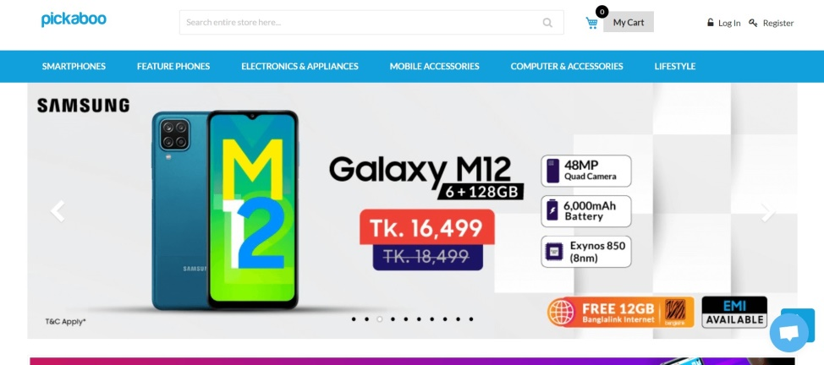
SOME EXAMPLES OF E-COMMERCE WEBSITE:
AMAZON
EBAY
PICKABOO
02
FLIPKART

Slide 4
ABOUT OUR WEBSITE:
Our ecommerce platform provides a seamless experience for both customers and administrators. Our website's customer panel showcases our available stock, while the admin interface efficiently manages backend operations and product data.
Administrators focus on seamlessly inserting products into our database for accuracy and efficiency, with data/information organized and stored for viewing and management via platforms like phpMyAdmin.
Customers enjoy a user-friendly interface for easy browsing of our offerings, with products neatly displayed on webpages within the customer panel for simple navigation.
This functionality ensures our ecommerce website is a reliable platform for smooth transactions, enhancing the overall shopping experience for all users.
03

Slide 5
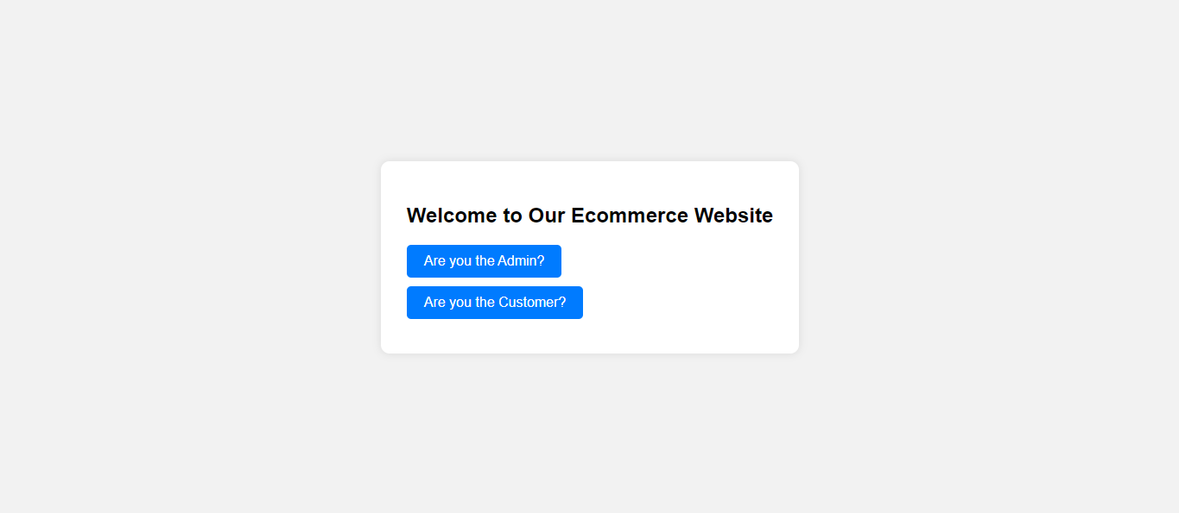
ENTRY POINT OF OUR WEBSITE
This page is the first page whenever someone enters in our website. It could be a technical guy or a non-technical guy. This page will ask if the user is the admin or a customer. Then it will redirect to the page as instructed.
04

Slide 6
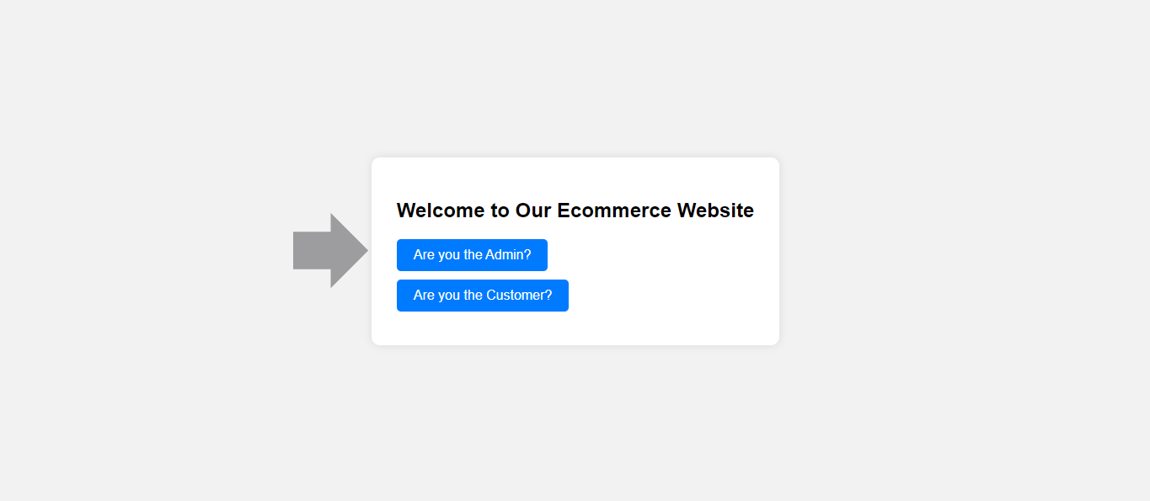
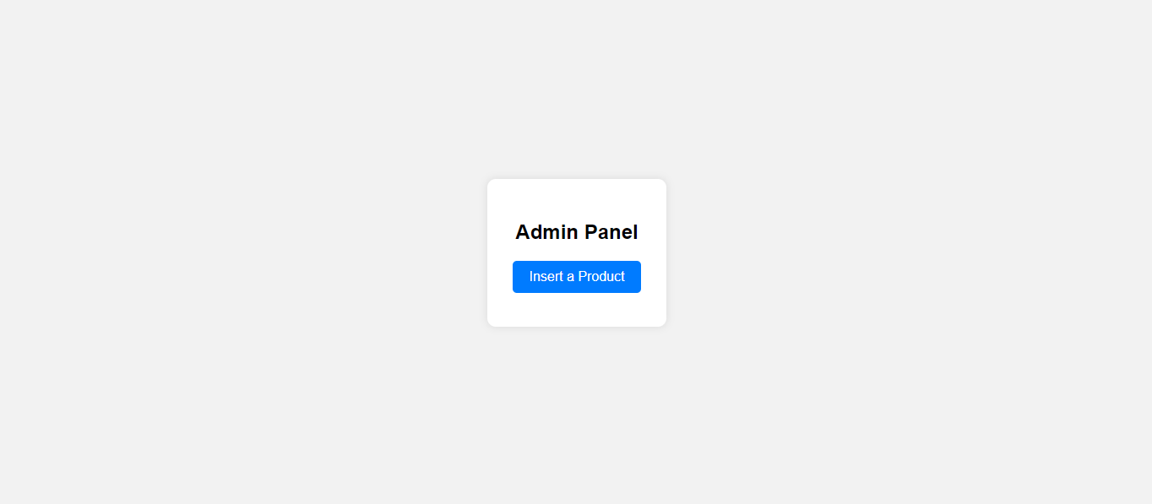
ADMIN PANEL
After clicking the “are you the admin” button this button will redirect to the webpage shown in the bottom which will ask you to insert the product.
05

Slide 7
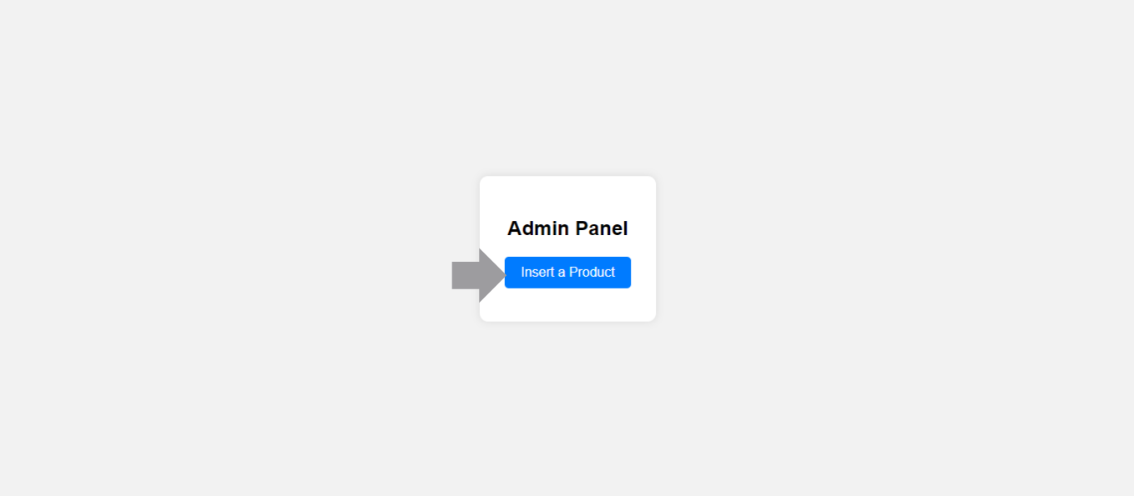
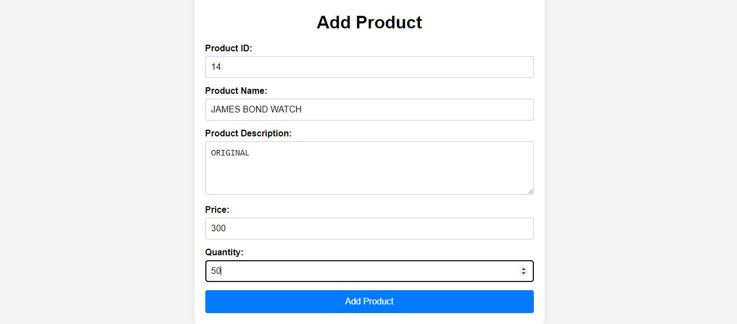
ADMIN PANEL
After clicking the button “insert product” the page in the bottom arrives. This page is responsible for taking the product information in the input and then insert it in the database. We have taken some inputs in this page which will be inserted in the database which can be viewed by phpMyAdmin.
06

Slide 8
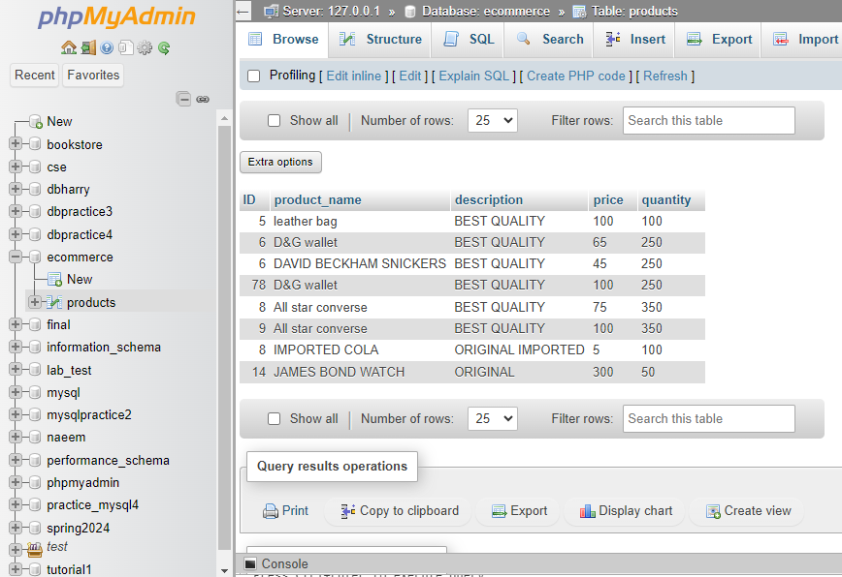
PhpMyAdmin
This is the main database/schema in the phpMyAdmin. We can see all the inserted products available in the stock and also just inserted products here.
07

Slide 9
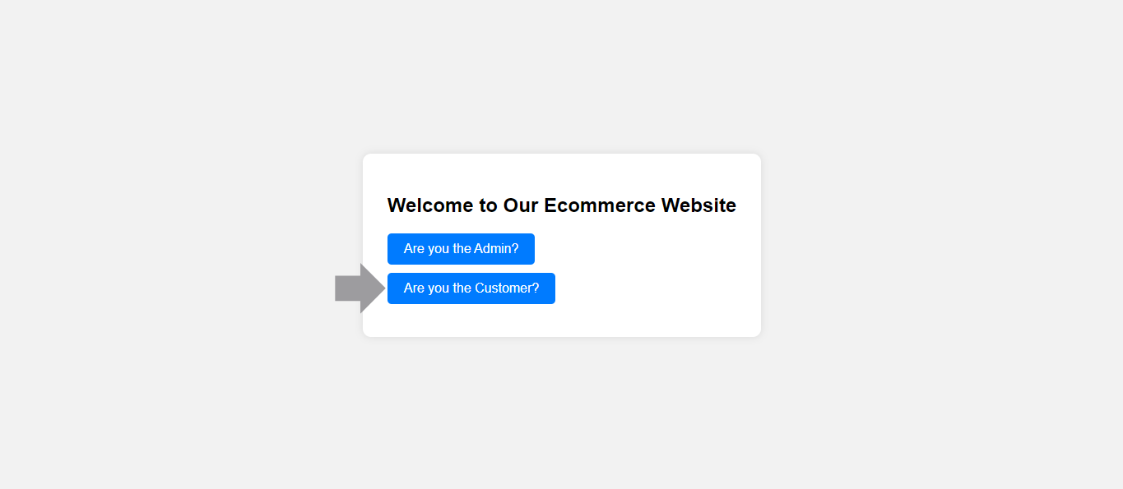
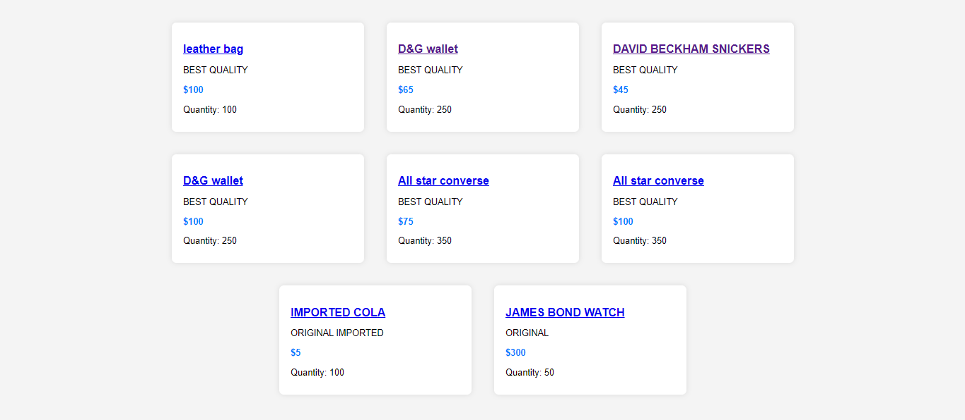
CUSTOMER PANEL
This is the customer panel which will come if someone clicks on the “are the customer button”.
08

Slide 10
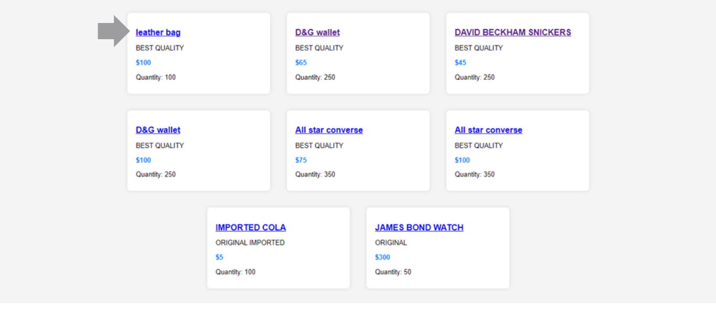
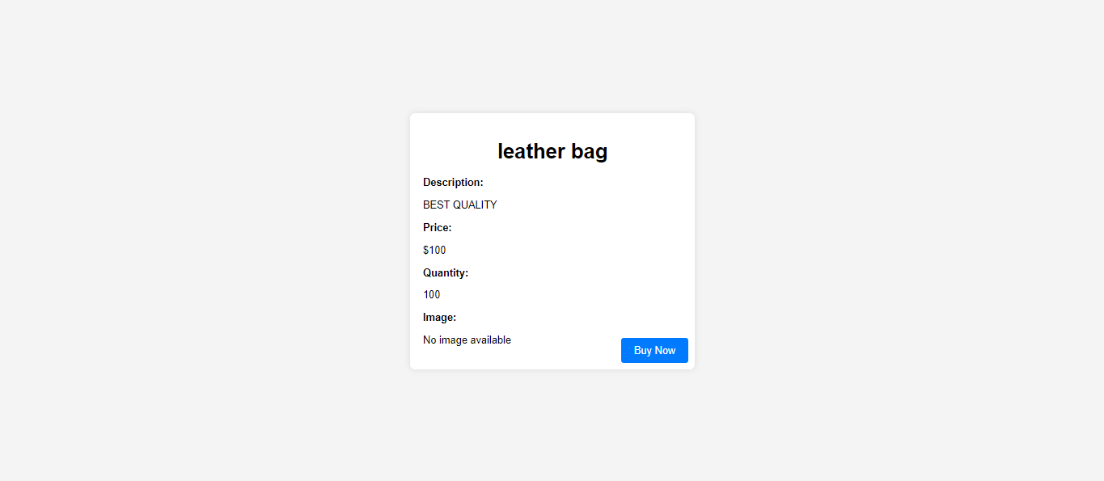
PRODUCT INFORMATION
This is the product information which will come if you click on a name of the product in the webpage. This page contains all the information of the product the price, name, description, and buy button if you are interested you can click it.
09

Slide 11
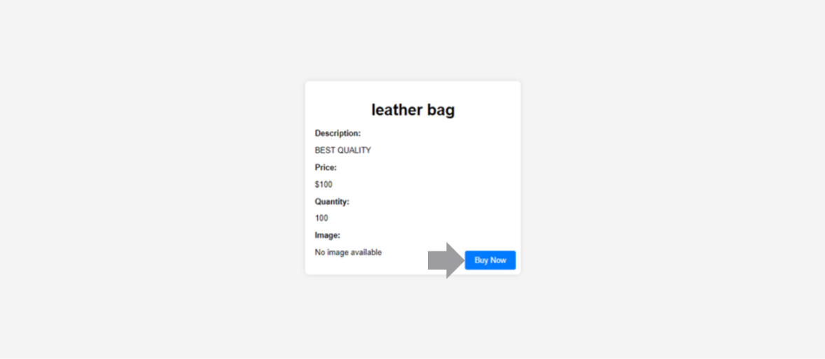
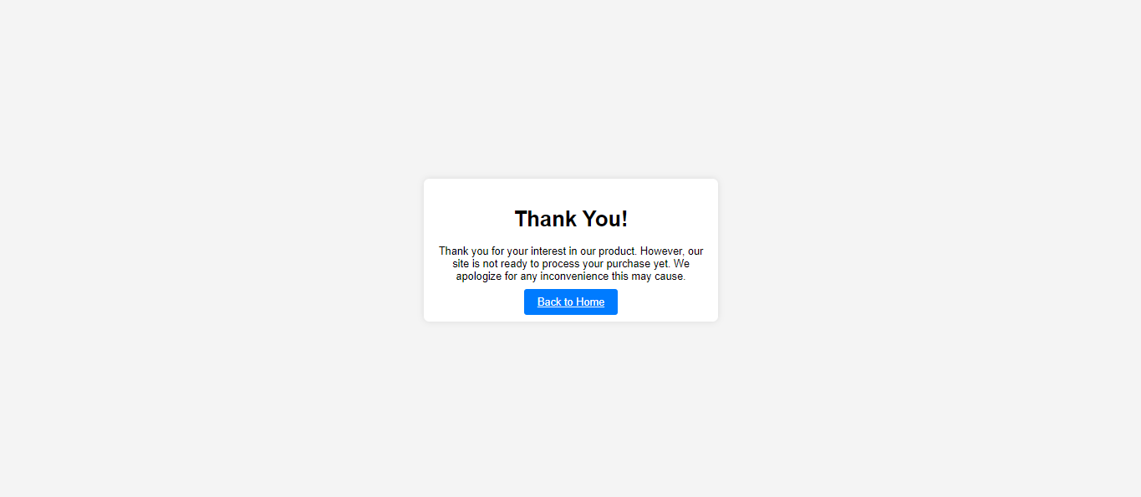
BUY BUTTON MESSAGE
This is the message that comes when someone clicks on the buy button. Since our website is not ready to make the purchase therefore this message will show. If someone clicks in the “Back to home” button in the bottom it will take us to the entry point.
10

Slide 12
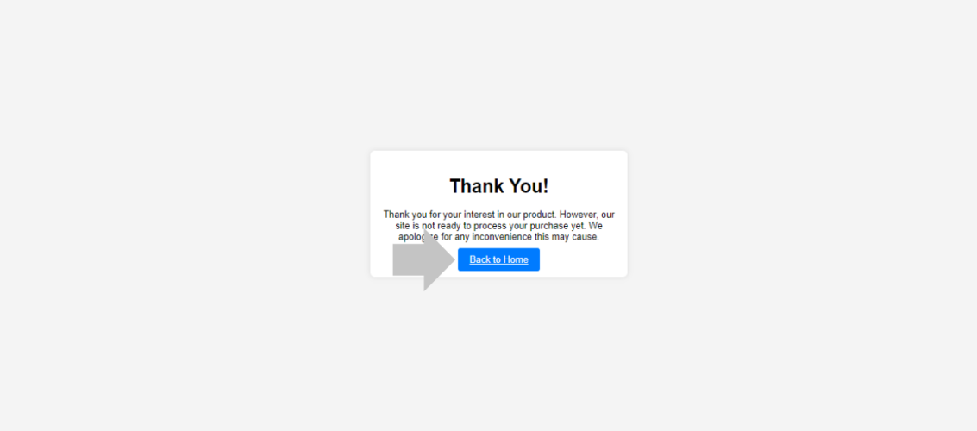
SCREEN AFTER CLICKING BACK TO HOME
This is the screen that comes after clicking the “back to home button”
11

Slide 13
THANK YOU
12

